Slide 1

LAMBASINGI TOURISM
Website Project Presentation
Misty Hills • Nature • Agriculture • Culture
MISTY HILLS
NATURE
AGRICULTURE
CULTURE
Presented by • Mohan Sai

Slide 2
PROJECT INTRODUCTION
A digital guide to explore Lambasingi
🌿
Nature
⛰
Adventure
☰
Project Structure
Beautiful hill destination surrounded by green mountains, forests and peaceful valleys.
The project presents opportunities such as trekking, camping and scenic sightseeing.
Home, About, Places, Agriculture, Gallery, Packages and Contact pages form the website.
THE LAND OF MISTY HILLS
LAMBASINGI TOURISM • MOHAN SAI
2

Slide 3
HOME PAGE
Discover Lambasingi from the first screen
✦
Hero Section
🌱
Welcome Section
“WELCOME TO LAMBASINGI” with “The Land of Misty Hills” and Explore Places / View Packages buttons.
“A Beautiful Escape Into Nature” with Nature • Adventure • Agriculture • Culture.
★
Features
📍
Popular Destinations
Misty Mountains, Green Forests, Coffee Plantations and Adventure.
Misty Hills, Waterfalls and Coffee Plantation, plus an agriculture preview.
LAMBASINGI TOURISM • MOHAN SAI
3

Slide 4

ABOUT PAGE
More than just a destination
🌫
WELCOME TO THE MISTY HILLS
🌿
Nature
☕
Agriculture
Lambasingi is presented as a scenic hill destination surrounded by green forests, mountains and peaceful valleys. The page highlights cool climate, misty landscapes, local culture and village life.
Green hills, forests and peaceful natural landscapes.
Coffee plantations and fresh local hill produce.
🏡
Village Life
📷
Photography
Peaceful mountain communities.
Landscapes and misty mountains.
LAMBASINGI TOURISM • MOHAN SAI
4

Slide 5
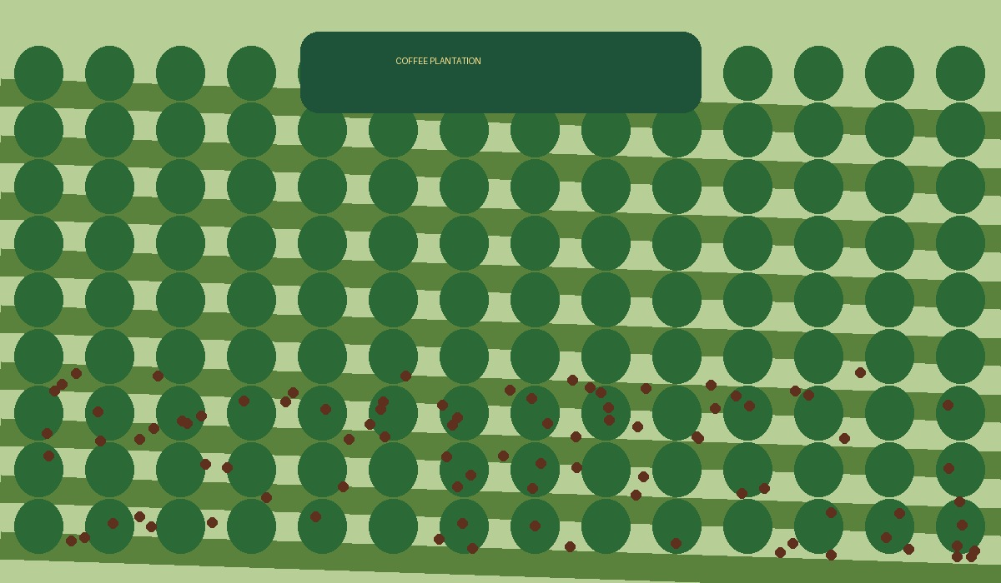
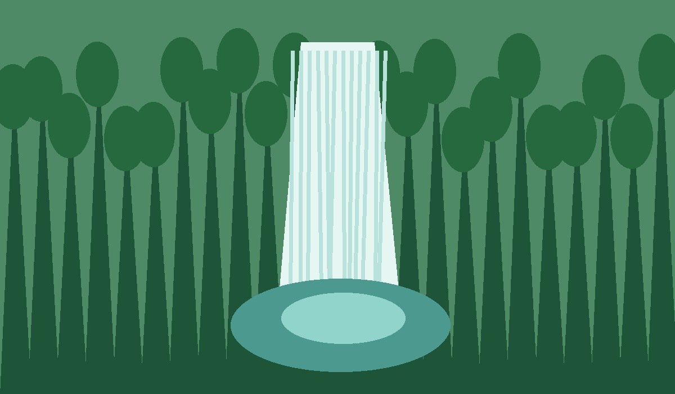
KEY WEBSITE FEATURES
Main attractions presented by the project
🌫
Misty Mountains
🌳
Green Forests
Mist-covered hills create a calm scenic atmosphere.
Lush forest landscapes surround the hill destination.
☕
Coffee Plantations
🥾
Adventure
Coffee plantations and local farming are part of hill life.
Trekking, camping and scenic sightseeing are featured.
NATURE + ADVENTURE
LAMBASINGI TOURISM • MOHAN SAI
5

Slide 6
AGRICULTURE
Where Nature and Farming Grow Together
☕
COFFEE
🍊
FRUITS
🥬
VEGETABLES
🌱
FARMING
Coffee is highlighted as an important part of hill agriculture.
The agriculture preview includes local fruits grown in the hills.
Fresh hill vegetables are included in the project’s agriculture theme.
Local farming traditions connect nature and village life.
WHERE NATURE & FARMING GROW TOGETHER
LAMBASINGI TOURISM • MOHAN SAI
6

Slide 7
TOURISM ACTIVITIES & DESTINATIONS
Places and experiences featured in the project
⛰
Misty Hills
💧
Waterfalls
☕
Coffee Plantation
Scenic mountain landscapes and misty viewpoints are a central visual theme.
Waterfalls are presented as a natural attraction within the destination content.
Coffee plantation experiences connect tourism with local agriculture.
PHOTOGRAPHY • SCENIC EXPERIENCES
LAMBASINGI TOURISM • MOHAN SAI
7

Slide 8
TECHNOLOGY & PROJECT WORKFLOW
Simple, page-wise website structure
01
02
03
04
05
06
HOME
→
ABOUT
→
PLACES
→
AGRICULTURE / GALLERY
→
PACKAGES
→
CONTACT
</>
Technology Used
CSS
Page-Wise Design
HTML for structure and content; CSS for layout, colors, responsive design and visual presentation.
The project is organized as separate HTML pages with corresponding CSS files.
LAMBASINGI TOURISM • MOHAN SAI
8

Slide 9
CONCLUSION
CONCLUSION
A simple and attractive digital tourism guide
A simple and attractive digital tourism guide
“Feel the mist. Explore the hills.
Create unforgettable memories.”
LAMBASINGI TOURISM
Project Presentation • Mohan Sai
LAMBASINGI TOURISM • MOHAN SAI
9

